Slide 1
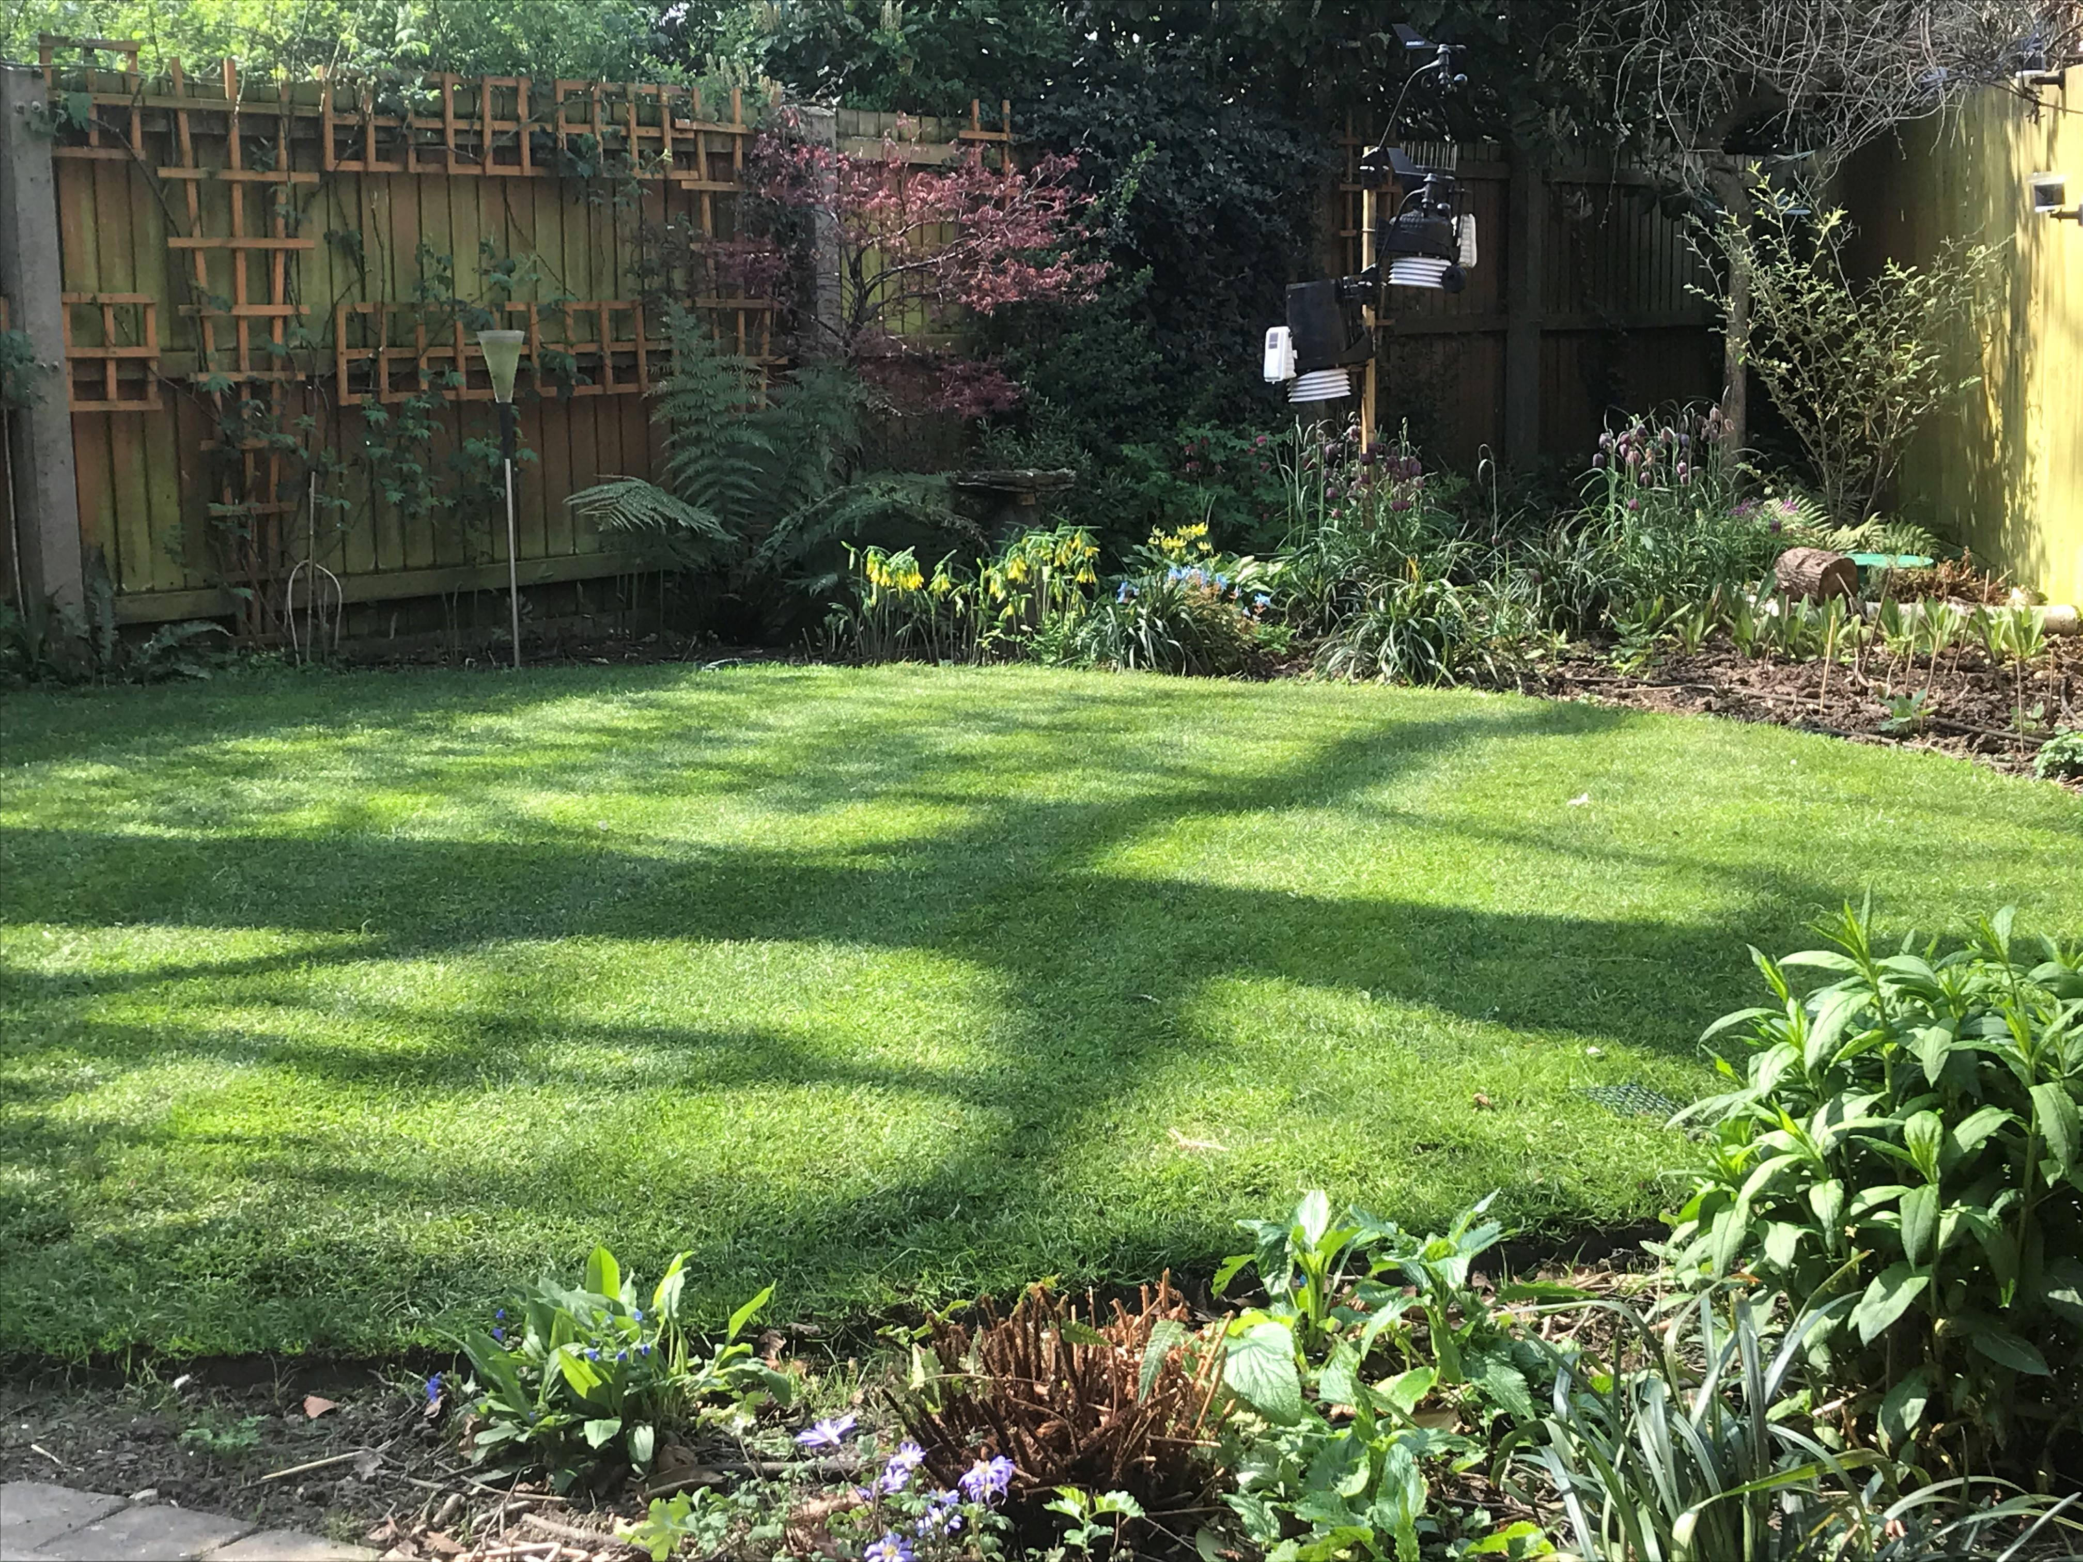
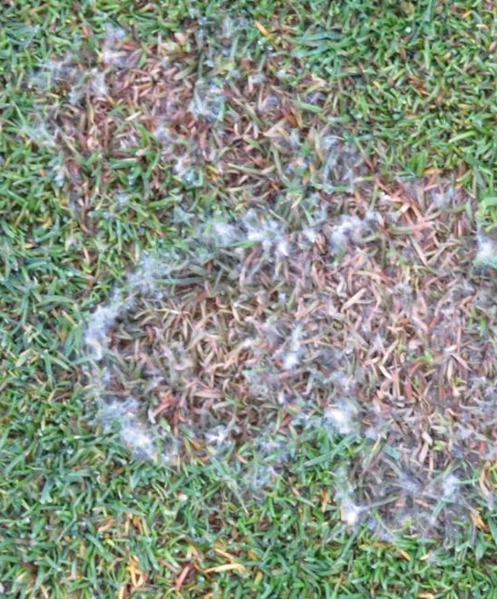
Weather patterns and their effect
on lawn management
Mark Hunt
Weather Analytics
Prodata Weather Systems

Slide 2
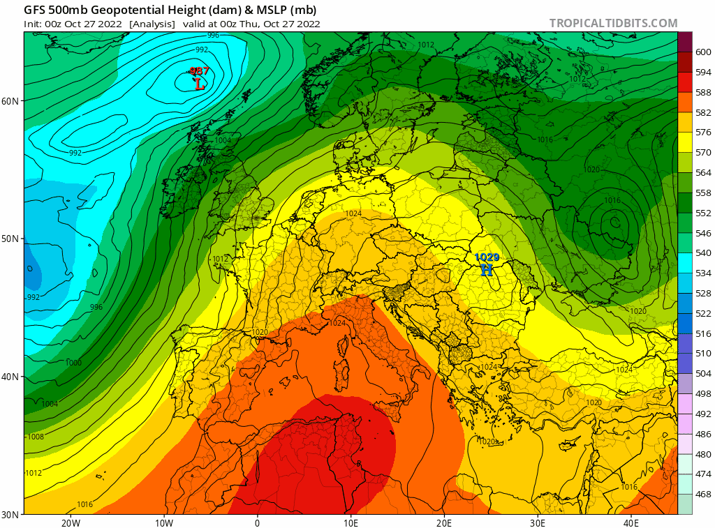
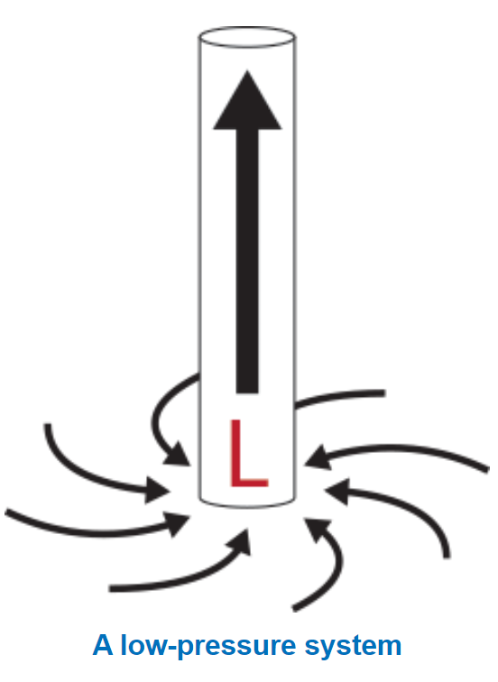
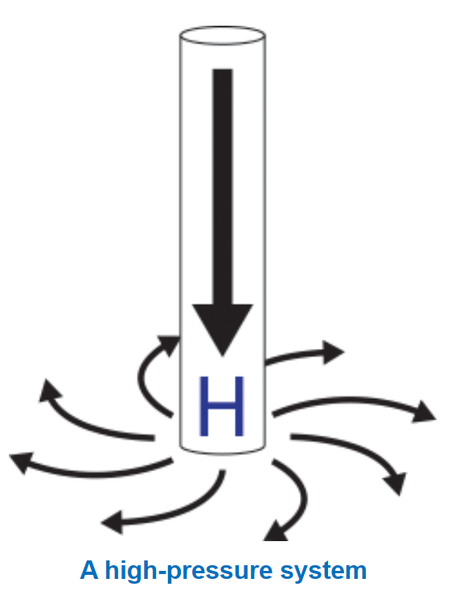
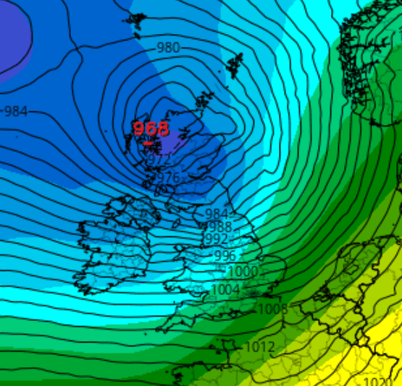
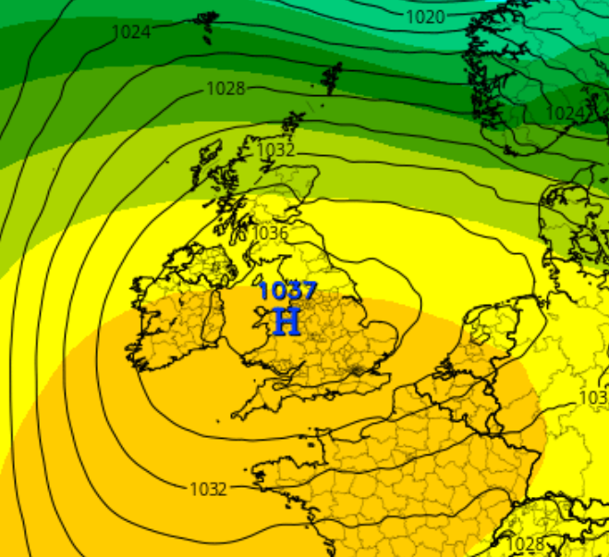
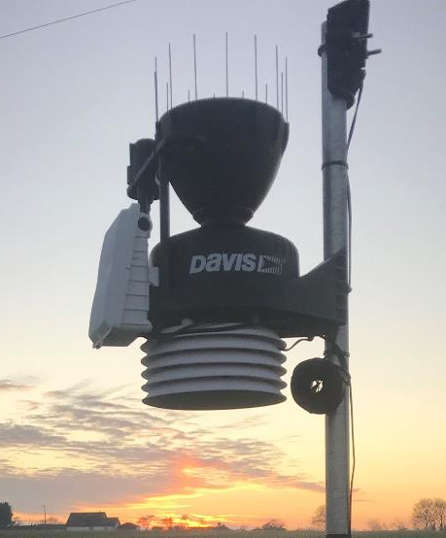
Weather Thematics
5.5 -7.5 miles
W
E
Jet Stream
High & low pressure systems
Localised topography
Weather Station

Slide 3
The Jet Stream and Blocking Events…
Weather Thematics

Slide 4
Climatic impacts on turfgrass management
There are 3 specific weather patterns that present regular agronomic challenges to lawncare management in the U.K & Ireland and they are all associated with Omega and Diffluent blocking events ;
Dry, cold springs..
Summer heatwaves
Humid and temperate autumns
Weather Thematics

Slide 5
Dry, cool springs……April rainfall & GDD Total - 2005 - 2022 - Location - The Oxfordshire, Thame
Over the last 18 years, we have not had a year with good rainfall and temperature.
The average is 95 GDD for the month but only 31.4 mm of rain….

Slide 6
Dry, cool springs……Daily Growth Potential – 2022 y.t.d – Location – Kings Norton

Slide 7
Dry, cool springs…Rainfall, E.T & Soil moisture Status - Location – Kings Norton

Slide 9
The Challenge
Dry, cold springs make planning aeration and nutrition difficult..
Unless irrigated, lawns can begin to go under drought stress from April, depending on geographical location.
Usually there’s respite in May, but drought stress returns from June onwards and lasts till the end of August from an E.T perspective.
Summer treatments of high nitrogen nutrition are therefore unwarranted and agronomically unsound.

Slide 10
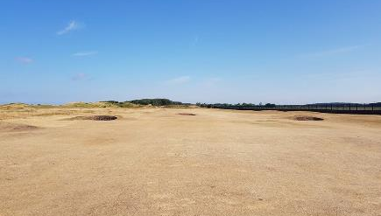
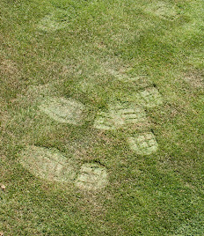
2. Omega Blocking &
Summer heatwaves..

Slide 11
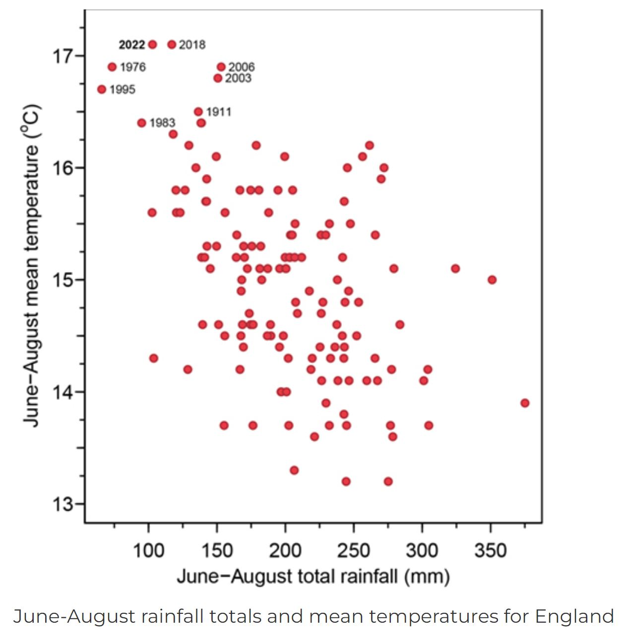
Warmest, driest summers
2022
2018
2006
2003
1995
1983
1976
1911
Data from https://www.ceh.ac.uk/news-and-media/blogs/why-we-are-still-drought-despite-recent-rain?
Stephen Turner, Hydrologist, UK Centre for Ecology & Hydrology

Slide 12
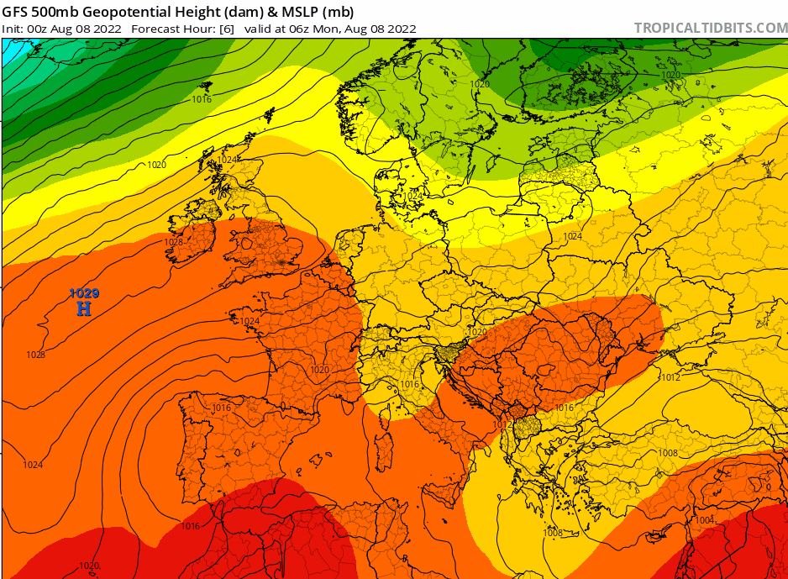
Omega Blocking Events & Summer heatwaves
Summer Omega Blocking Patterns have some important features ;
They tend to be easier to forecast and both of this summer’s heatwaves appeared on GFS predictions 10-14 days before they actually occurred..
Their pattern is proving to be similar over the last few years in that Mediterranean / African air is pushed northwards into a stable high pressure system..
They build over time and so far in our climate, the peaks tend to be short-lived..
This is the August 2022 heatwave..
Heat isn’t the only issue…. Evapotranspiration (E.T) is also a problem..

Slide 13
Max air temperature and E.T and Growth – Summer 2022 – Location – Kings Norton
The effect of high E.T on the plant is more significant than high temperature during summer

Slide 14
Omega Blocking Events & Summer heatwaves
Above this temperature, the grass plant’s consumes more energy during respiration than it creates through photosynthesis.
Loss of shoot and root development
Plant becomes semi-dormant.
This threshold point is reached sooner in high surface organic matter scenario’s and with different plant species Poa annua var. annua vs. reptans for example
In general, the better your root system, the higher the tolerance of your grass plant to summer heat
Applying high nitrogen summer fertiliser depletes energy reserves
Photosynthesis
Respiration
2 4 6 8
M mols CO₂ m²
NAR = positive
NAR = negative
20°C 25°C 30°C 35°C 40 °C

Slide 15
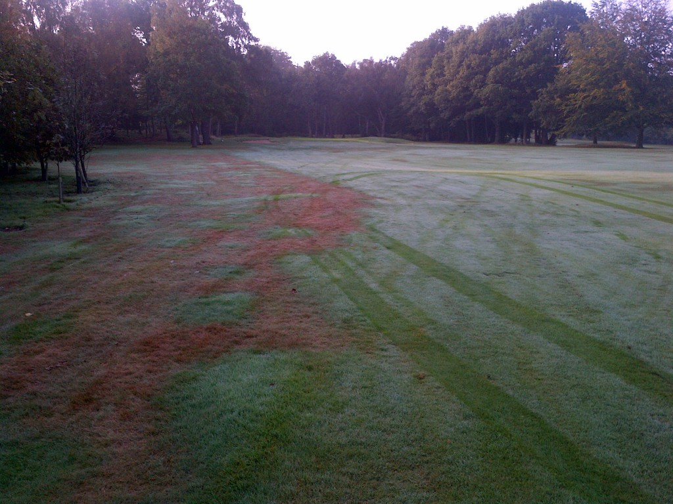
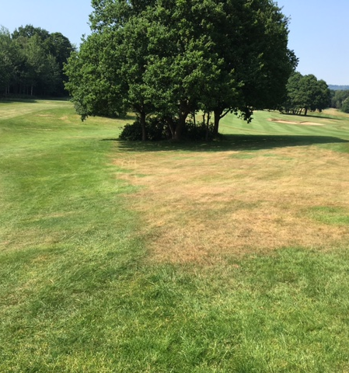
-VTD
+VTD
-VTD
The key to surviving summer droughts is good organic matter management and above all, good rooting…..

Slide 16
The Challenge
Prior to and during the summer, applications of wetting agents, biostimulants and plant growth regulations are more important than just straight nutrition in a lawn scenario…
The higher the level of plant stress, the more susceptible certain grass species are to diseases once dew and humidity arrives at the end of August..
Red Thread, Dollar Spot, Anthracnose and Microdochium nivale are all stress-related diseases..

Slide 17
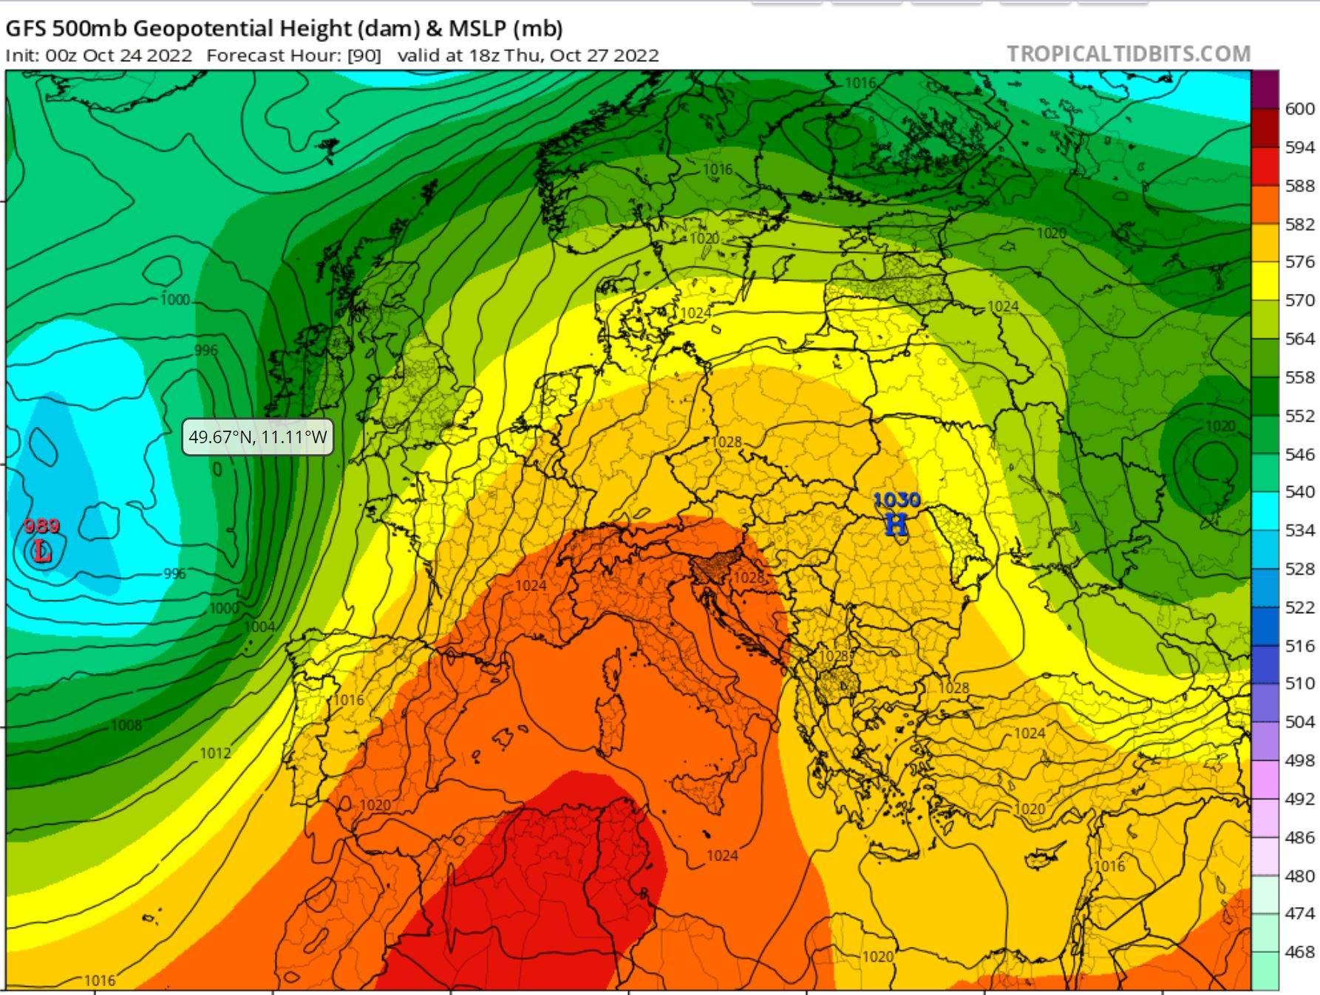
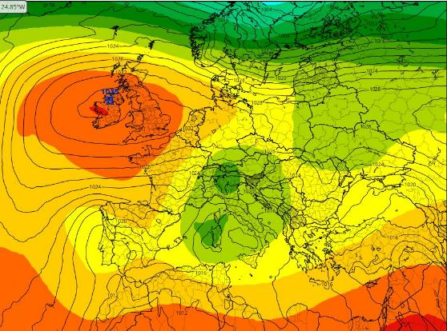
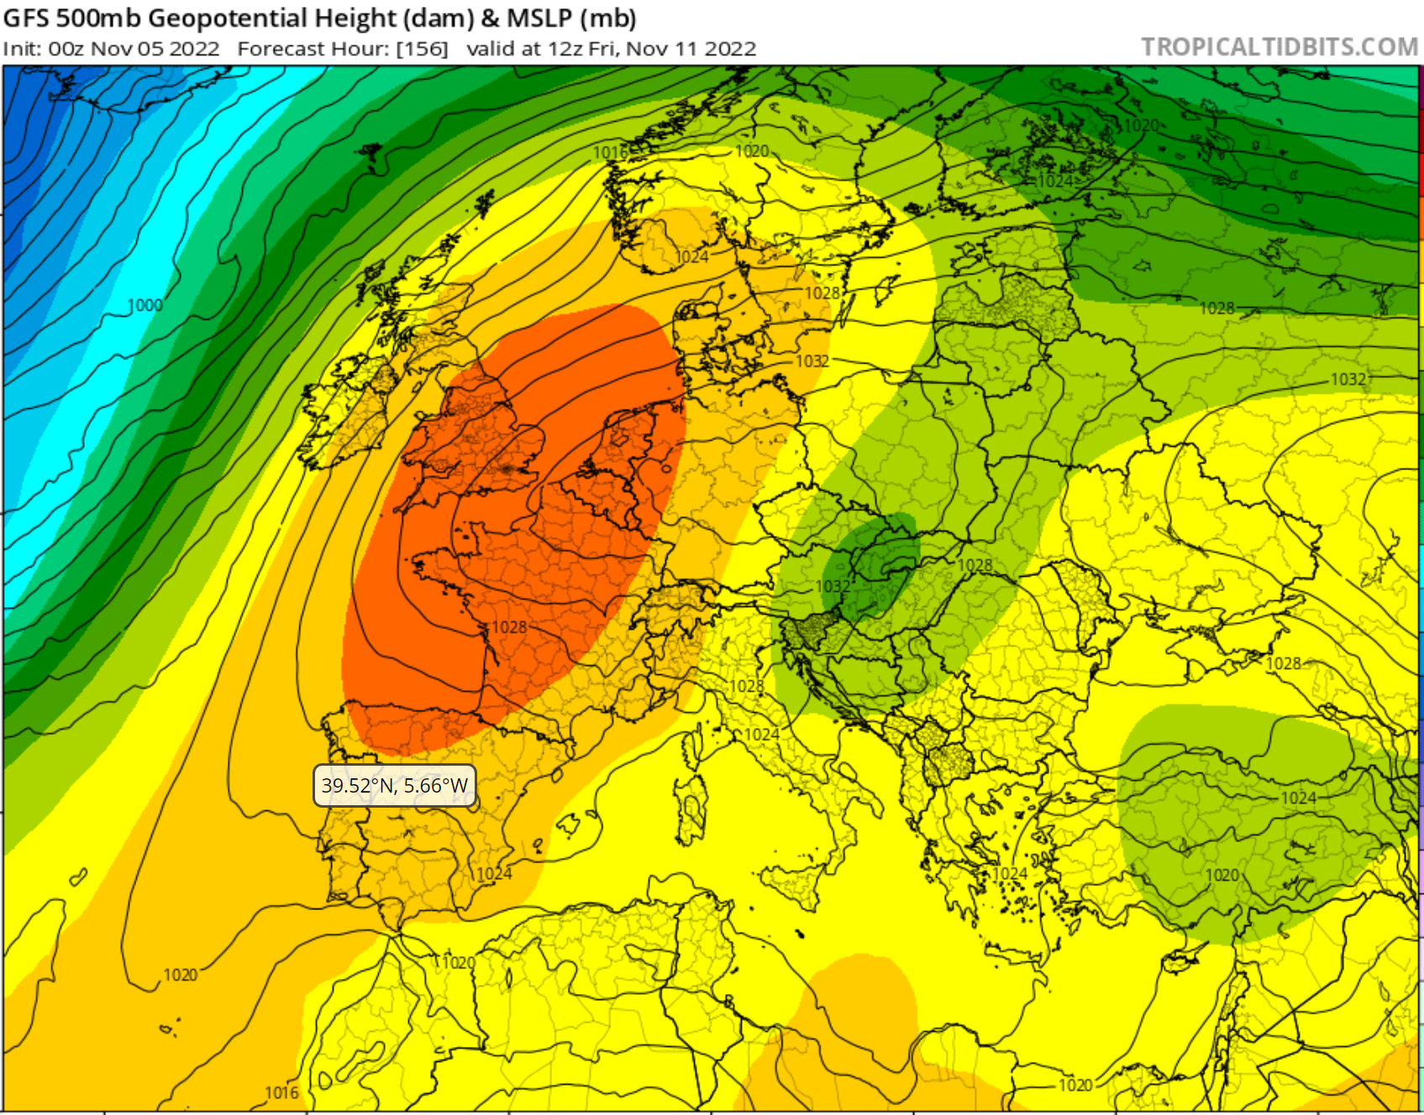
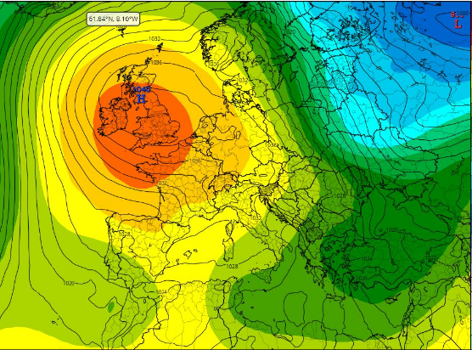
Omega Blocking Events & Autumn / Winter humid, temperate weather
27th October, 2022
10th October, 2021
11th November, 2022
18th December, 2021
The source of the warm humid air is usually Africa, Spain, Portugal or Southern France…

Slide 18
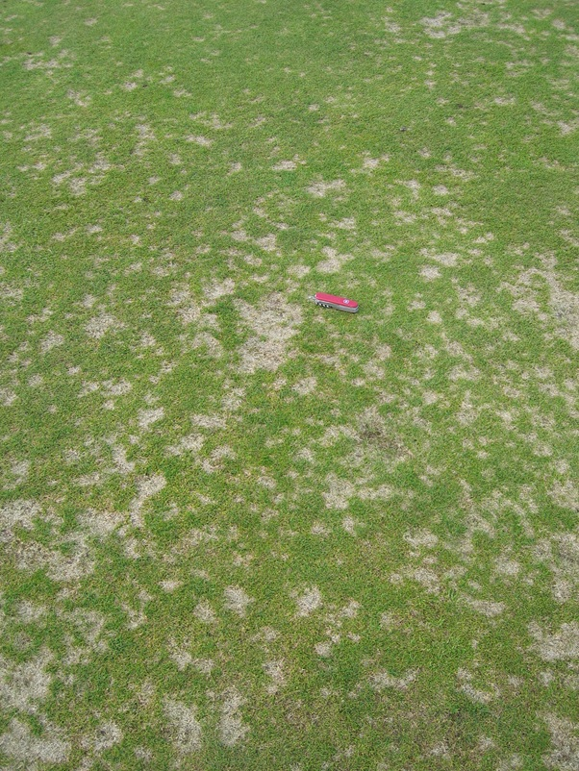
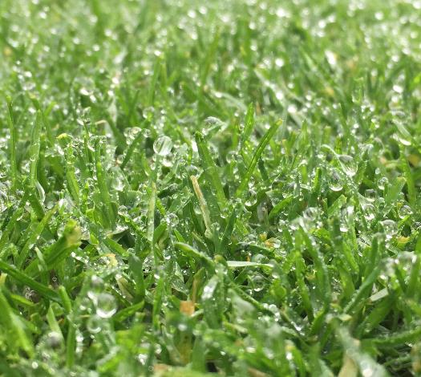
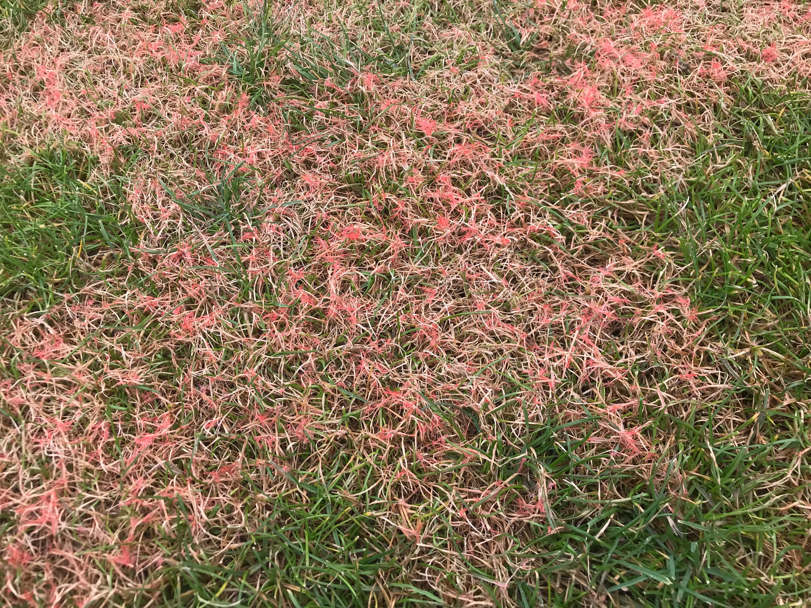
All of these turf diseases are primarily encouraged by plant leaf wetness (dew)
They can be managed by nutrition to a large extent without a pesticide application.
I expect Dollar Spot to become more problematic in a lawncare situation in the future. This disease favours Fescue, Ryegrass and Poa annua…
Microdochium
Dollar Spot
Red Thread
Dew & Guttation Fluid

Slide 19
The Smith Kerns Dollar Spot model predicts the probability of this disease using humidity and air temperature…..
The main activity period of Dollar Spot is when over night dew begins to form on a frequent basis, typically from late August.
Depending on the autumn, it can continue right through to mid-November nowadays due to humid Omega blocking events…..

Slide 20
Thanks for listening today
If you’d like to talk about Davis weather stations,
markh@weatherstations.co.uk
Or follow my weekly weather blog just go to ;
www.weatherblog.co.uk and sign up !

